Slide 1
Non-freeness of subgroups of SL(2,R) generated by two parabolics
Chan Jun Da
A0150025Y

Slide 2
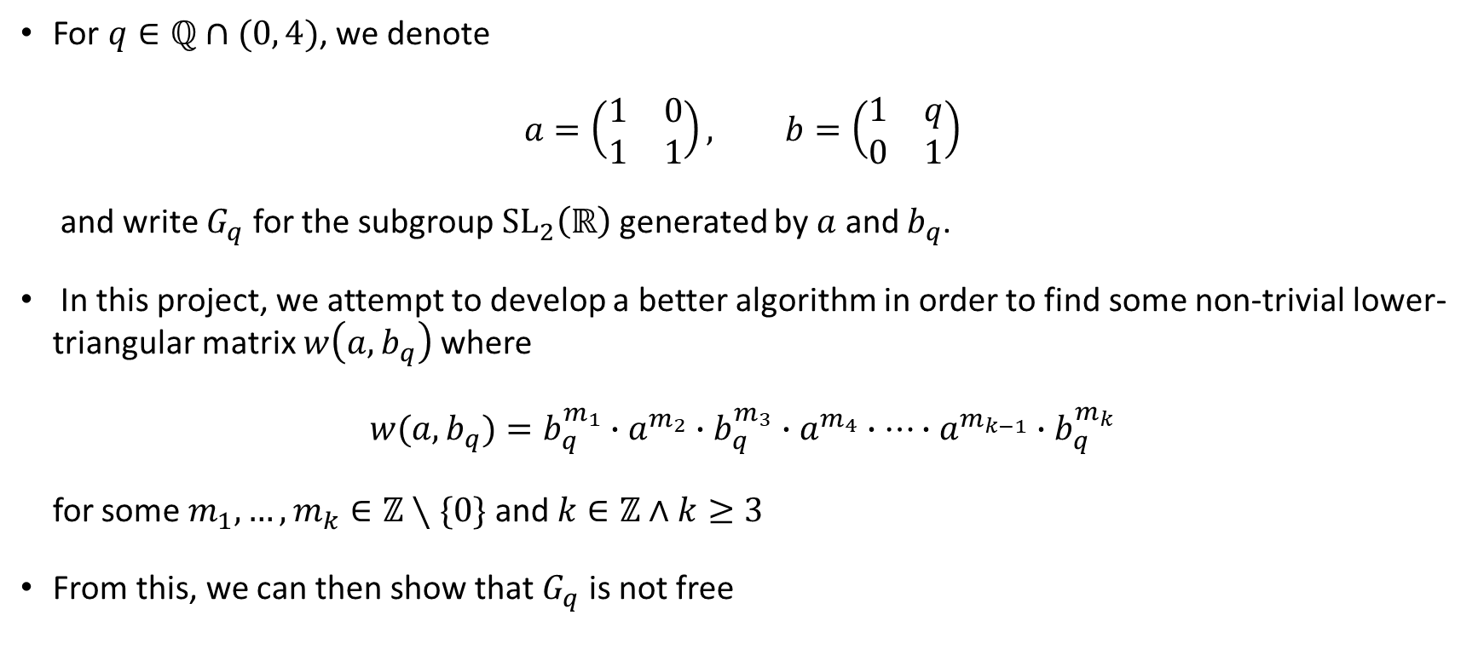
Introduction
For $q∈ℚ∩(0, 4)$, we denote
$$a=\left(\begin{matrix}1 & 0 \\ 1 & 1\end{matrix}\right), b=\left(\begin{matrix}1 & q \\ 0 & 1\end{matrix}\right)$$
and write $G_{q}$ for the subgroup ${SL}_{2}\left(ℝ\right)$ generated by $a$ and $b_{q}$.
In this project, we attempt to develop a better algorithm in order to find some non-trivial lower-triangular matrix $w\left(a,b_{q}\right)$ where
$$w(a, b_{q})=b_{q}^{m_{1}}∙a^{m_{2}}∙b_{q}^{m_{3}}∙a^{m_{4}}∙…∙a^{m_{k−1}}∙b_{q}^{m_{k}}$$
for some $m_{1},…,m_{k}∈ℤ∖\{0\}$ and $k∈ℤ∧k≥3$
From this, we can then show that $G_{q}$ is not free

Slide 3
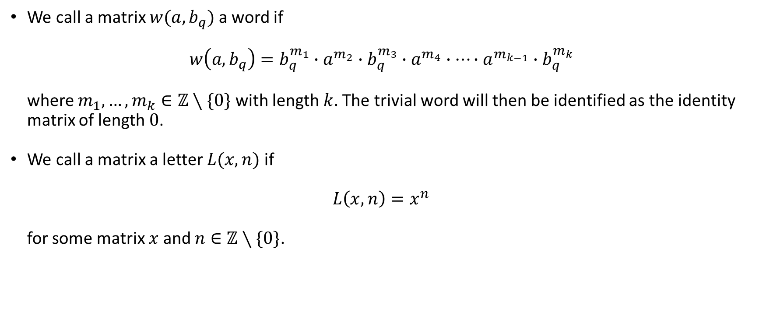
Definitions
We call a matrix $w(a,b_{q})$ a word if
$$w\left(a, b_{q}\right)=b_{q}^{m_{1}}∙a^{m_{2}}∙b_{q}^{m_{3}}∙a^{m_{4}}∙…∙a^{m_{k−1}}∙b_{q}^{m_{k}}$$
where $m_{1},…,m_{k}∈ℤ∖\{0\}$ with length $k$. The trivial word will then be identified as the identity
matrix of length $0$.
We call a matrix a letter $L(x, n)$ if
$$L\left(x,n\right)=x^{n}$$
for some matrix $x$ and $n∈ℤ∖\{0\}$.

Slide 4
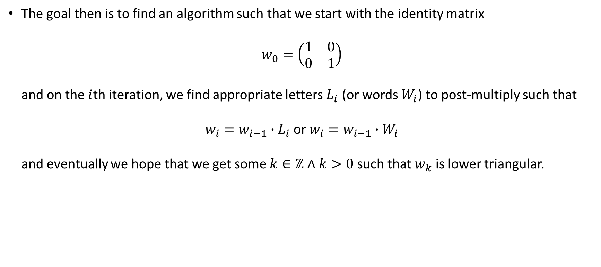
Goal
The goal then is to find an algorithm such that we start with the identity matrix
$$w_{0}=\left(\begin{matrix}1 & 0 \\ 0 & 1\end{matrix}\right)$$
and on the $i$th iteration, we find appropriate letters $L_{i}$ (or words $W_{i}$) to post-multiply such that
$w_{i}=w_{i−1}∙L_{i}$ or $w_{i}=w_{i−1}∙W_{i}$
and eventually we hope that we get some $k∈ℤ∧k>0$ such that $w_{k}$ is lower triangular.

Slide 5
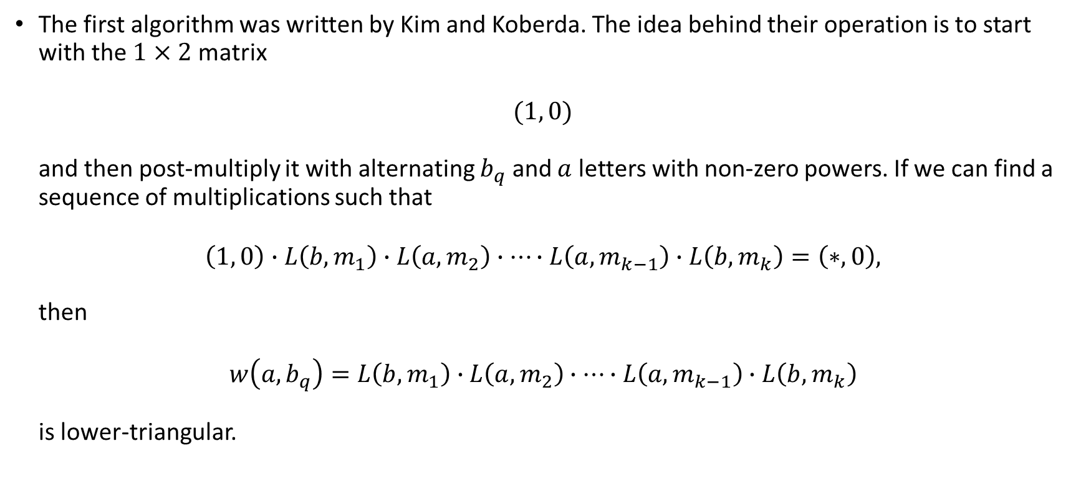
Starting Algorithm
The first algorithm was written by Kim and Koberda. The idea behind their operation is to start with the $1×2$ matrix
$$(1, 0)$$
and then post-multiply it with alternating $b_{q}$ and $a$ letters with non-zero powers. If we can find a
sequence of multiplications such that
$$\left(1, 0\right)∙L\left(b,m_{1}\right)∙L\left(a,m_{2}\right)∙…∙L\left(a,m_{k−1}\right)∙L\left(b,m_{k}\right)=\left(∗, 0\right),$$
then
$$w\left(a,b_{q}\right)=L\left(b,m_{1}\right)∙L\left(a,m_{2}\right)∙…∙L\left(a,m_{k−1}\right)∙L\left(b,m_{k}\right)$$
is lower-triangular.

Slide 6
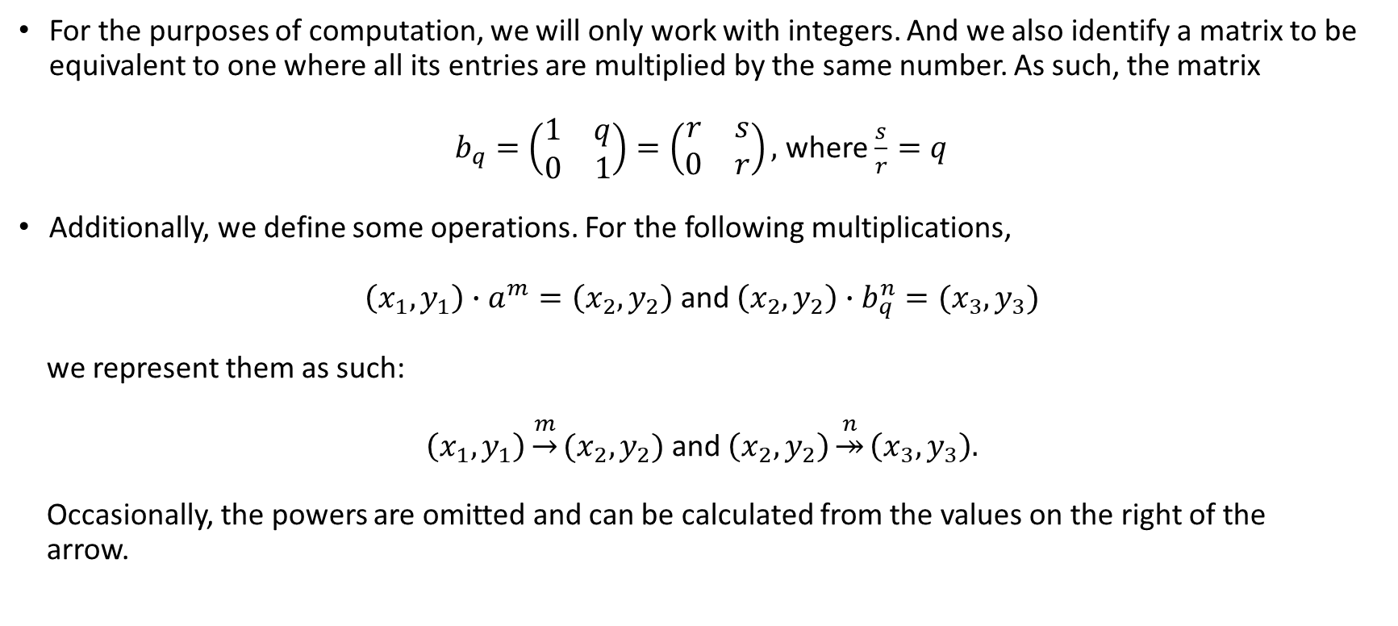
Starting Algorithm
For the purposes of computation, we will only work with integers. And we also identify a matrix to be equivalent to one where all its entries are multiplied by the same number. As such, the matrix
$b_{q}=\left(\begin{matrix}1 & q \\ 0 & 1\end{matrix}\right)=\left(\begin{matrix}r & s \\ 0 & r\end{matrix}\right),$ where $\frac{s}{r}=q$
Additionally, we define some operations. For the following multiplications,
$\left(x_{1},y_{1}\right)∙a^{m}=\left(x_{2},y_{2}\right)$ and $\left(x_{2},y_{2}\right)∙b_{q}^{n}=(x_{3},y_{3})$
we represent them as such:
$\left(x_{1},y_{1}\right)\underset{→}{m}(x_{2},y_{2})$ and $\left(x_{2},y_{2}\right)\underset{↠}{n}\left(x_{3},y_{3}\right).$
Occasionally, the powers are omitted and can be calculated from the values on the right of the
arrow.

Slide 7

Starting Algorithm
We also define an additional operation not used in the algorithm by Kim and Koberda. For some word, $w$, we denote the post multiplication of the word $w$
$$\left(x_{1},y_{1}\right)∙w=(x_{2},y_{2})$$
as
$$\left(x_{1},y_{1}\right)\underset{↣}{w}(x_{2},y_{2})$$

Slide 8
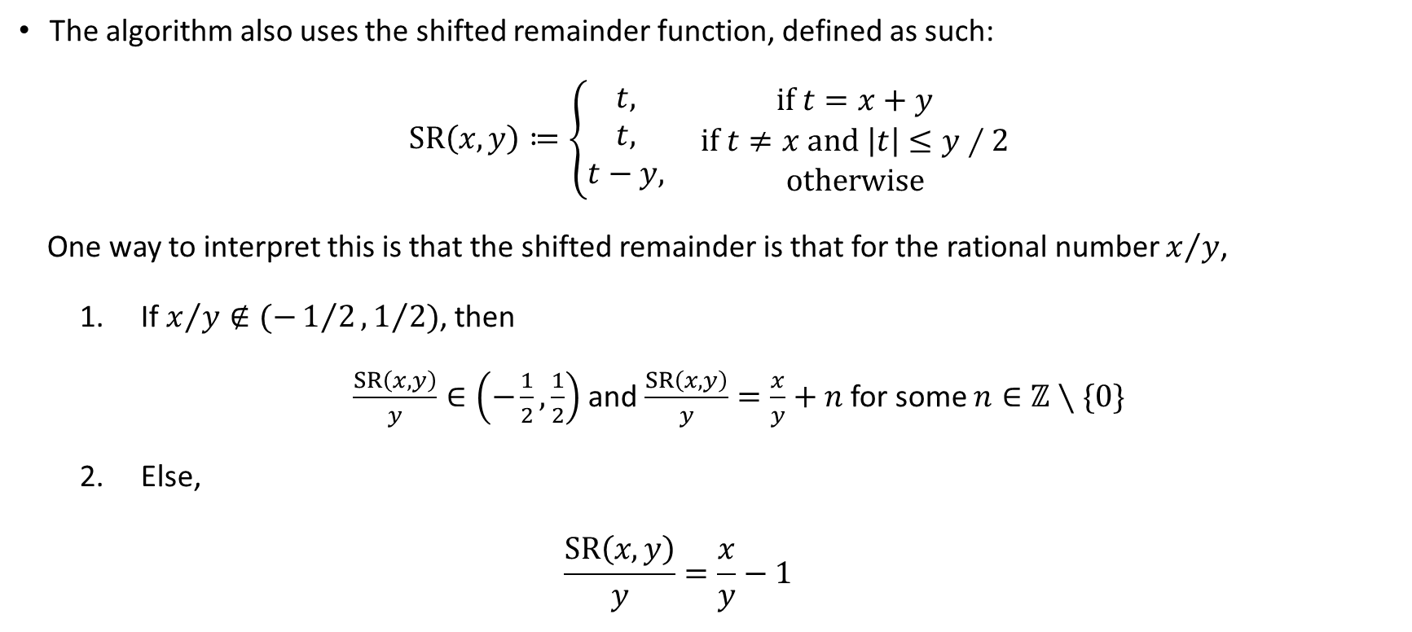
Starting Algorithm: Shifted Remainder
The algorithm also uses the shifted remainder function, defined as such:
$SR\left(x,y\right)≔\left\{\begin{aligned}t, \\ t, \\ t−y,\end{aligned}\right.$ $\begin{matrix}if t=x+y \\ if t≠x and \left|t\right|≤y∕2 \\ otherwise\end{matrix}$
One way to interpret this is that the shifted remainder is that for the rational number $x/y$,
If $x/y∉(−1/2,1/2)$, then
$\frac{SR\left(x,y\right)}{y}∈\left(−\frac{1}{2},\frac{1}{2}\right)$ and$\frac{SR\left(x,y\right)}{y}=\frac{x}{y}+n$ for some $n∈ℤ∖\{0\}$
Else,
$$\frac{SR\left(x,y\right)}{y}=\frac{x}{y}−1$$

Slide 9
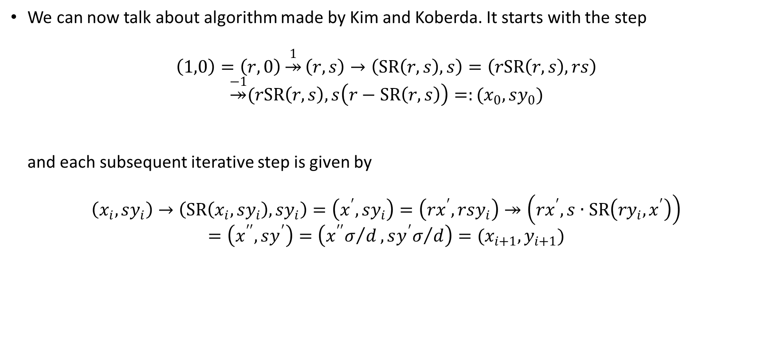
Starting Algorithm
We can now talk about algorithm made by Kim and Koberda. It starts with the step
$$\left(1,0\right)=\left(r,0\right)\underset{↠}{1}\left(r,s\right)→\left(SR\left(r,s\right),s\right)=\left(rSR\left(r,s\right),rs\right)$$
$$\underset{↠}{−1}(rSR\left(r,s\right),s\left(r−SR\left(r,s\right)\right)=:(x_{0},sy_{0})$$
and each subsequent iterative step is given by
$$\left(x_{i},sy_{i}\right)→\left(SR\left(x_{i},sy_{i}\right), sy_{i}\right)=\left(x^{′},sy_{i}\right)=\left(rx^{′},rsy_{i}\right)↠\left(rx^{′},s∙SR\left(ry_{i},x^{′}\right)\right)$$
$$=\left(x^{′′},sy^{′}\right)=\left({x^{′′}σ}/d,{sy^{′}σ}/d\right)=(x_{i+1},y_{i+1})$$

Slide 10
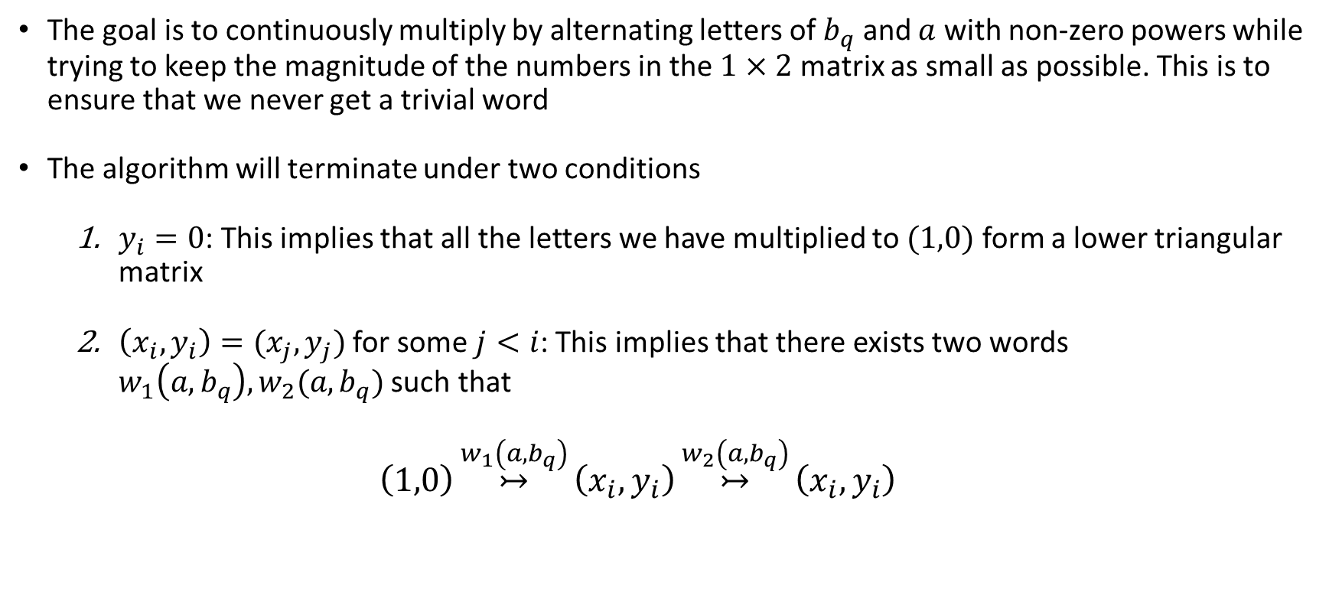
Starting Algorithm: Terminating Conditions
The goal is to continuously multiply by alternating letters of $b_{q}$ and $a$ with non-zero powers while trying to keep the magnitude of the numbers in the $1×2$ matrix as small as possible. This is to ensure that we never get a trivial word
The algorithm will terminate under two conditions
$y_{i}=0$: This implies that all the letters we have multiplied to $(1,0)$ form a lower triangular matrix
$\left(x_{i},y_{i}\right)=(x_{j},y_{j})$ for some $j<i$: This implies that there exists two words $w_{1}\left(a,b_{q}\right),w_{2}(a,b_{q})$ such that
$$\left(1,0\right)\underset{↣}{w_{1}\left(a,b_{q}\right)}\left(x_{i},y_{i}\right)\underset{↣}{w_{2}\left(a,b_{q}\right)}\left(x_{i},y_{i}\right)$$

Slide 11

Starting Algorithm: Terminating Conditions
(continued) $\left(x_{i},y_{i}\right)=(x_{j},y_{j})$ for some $j<i$: Then it is evident that
$$(1,0)\underset{↣}{w_{1}\left(a,b_{q}\right)}(x_{i},y_{i})\underset{↣}{w_{2}\left(a,b_{q}\right)}(x_{i},y_{i})\underset{↣}{{\left(w_{1}\left(a,b_{q}\right)\right)}^{−1}}(1,0)$$
Then, it is evident that the word
$$w\left(a,b_{q}\right)=w_{1}\left(a,b_{q}\right)∙w_{2}\left(a,b_{q}\right)∙{\left(w_{1}\left(a,b_{q}\right)\right)}^{−1}$$
is lower-triangular.

Slide 12
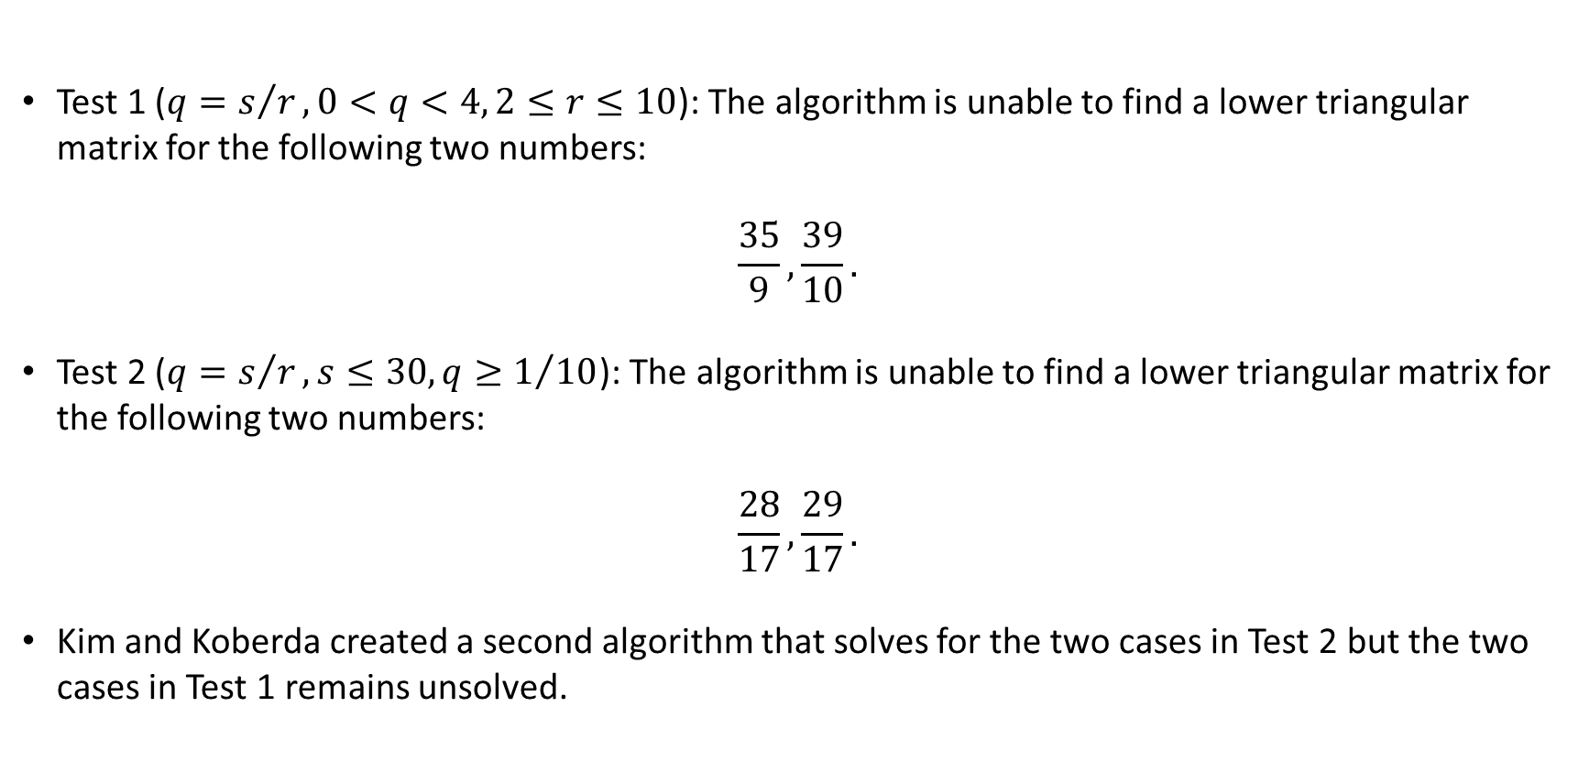
Starting Algorithm: Results
Test 1 ($q=s/r, 0<q<4, 2≤r≤10$): The algorithm is unable to find a lower triangular matrix for the following two numbers:
$$\frac{35}{9},\frac{39}{10}.$$
Test 2 ($q=s/r, s≤30, q≥1/{10}$): The algorithm is unable to find a lower triangular matrix for the following two numbers:
$$\frac{28}{17},\frac{29}{17}.$$
Kim and Koberda created a second algorithm that solves for the two cases in Test 2 but the two cases in Test 1 remains unsolved.

Slide 13
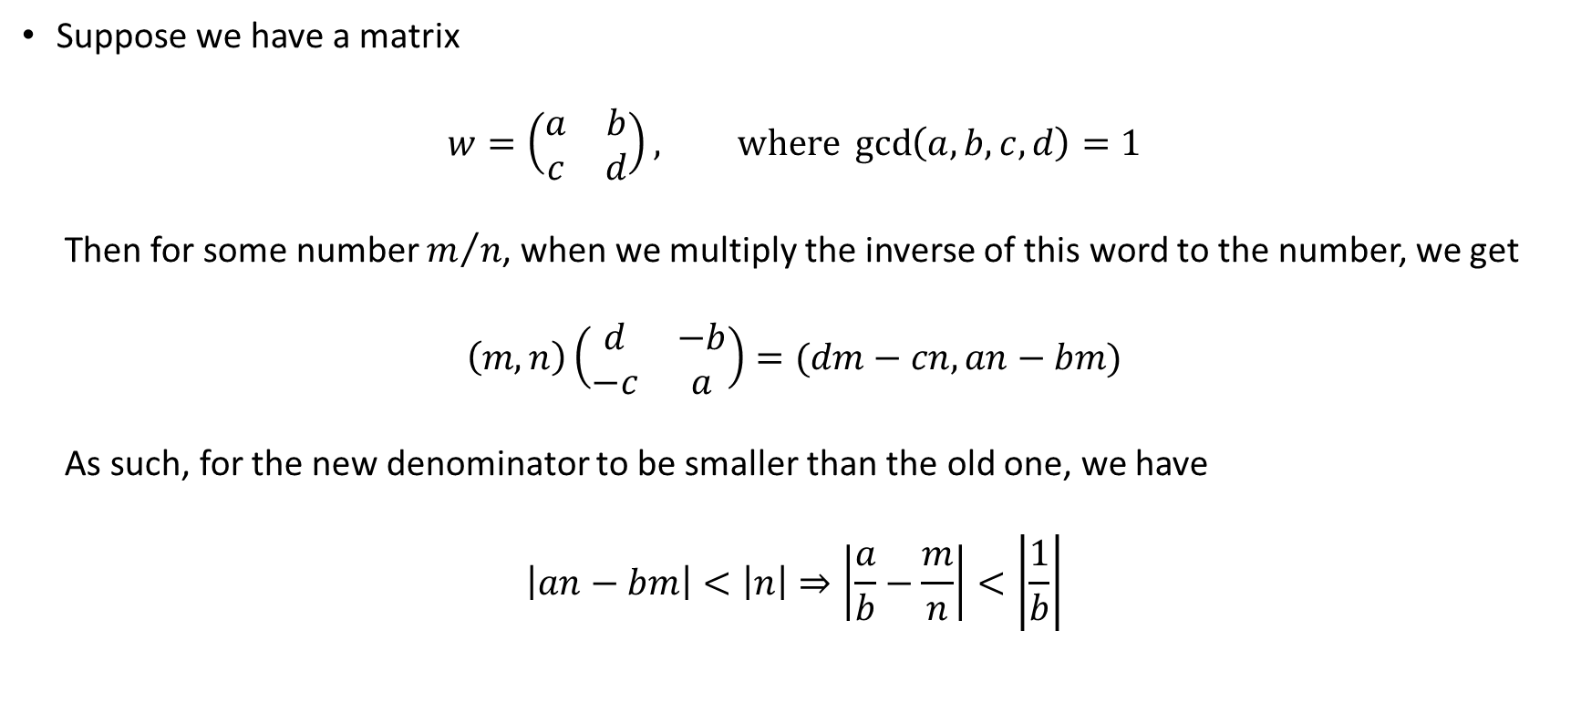
Killer Interval Algorithm: Killer Intervals
Suppose we have a matrix
$$w=\left(\begin{matrix}a & b \\ c & d\end{matrix}\right), where\gcd\left(a,b,c,d\right)=1$$
Then for some number $m/n$, when we multiply the inverse of this word to the number, we get
$$\left(m, n\right)\left(\begin{matrix}d & −b \\ −c & a\end{matrix}\right)=(dm−cn,an−bm)$$
As such, for the new denominator to be smaller than the old one, we have
$$\left|an−bm\right|<\left|n\right|⇒\left|\frac{a}{b}−\frac{m}{n}\right|<\left|\frac{1}{b}\right|$$

Slide 14
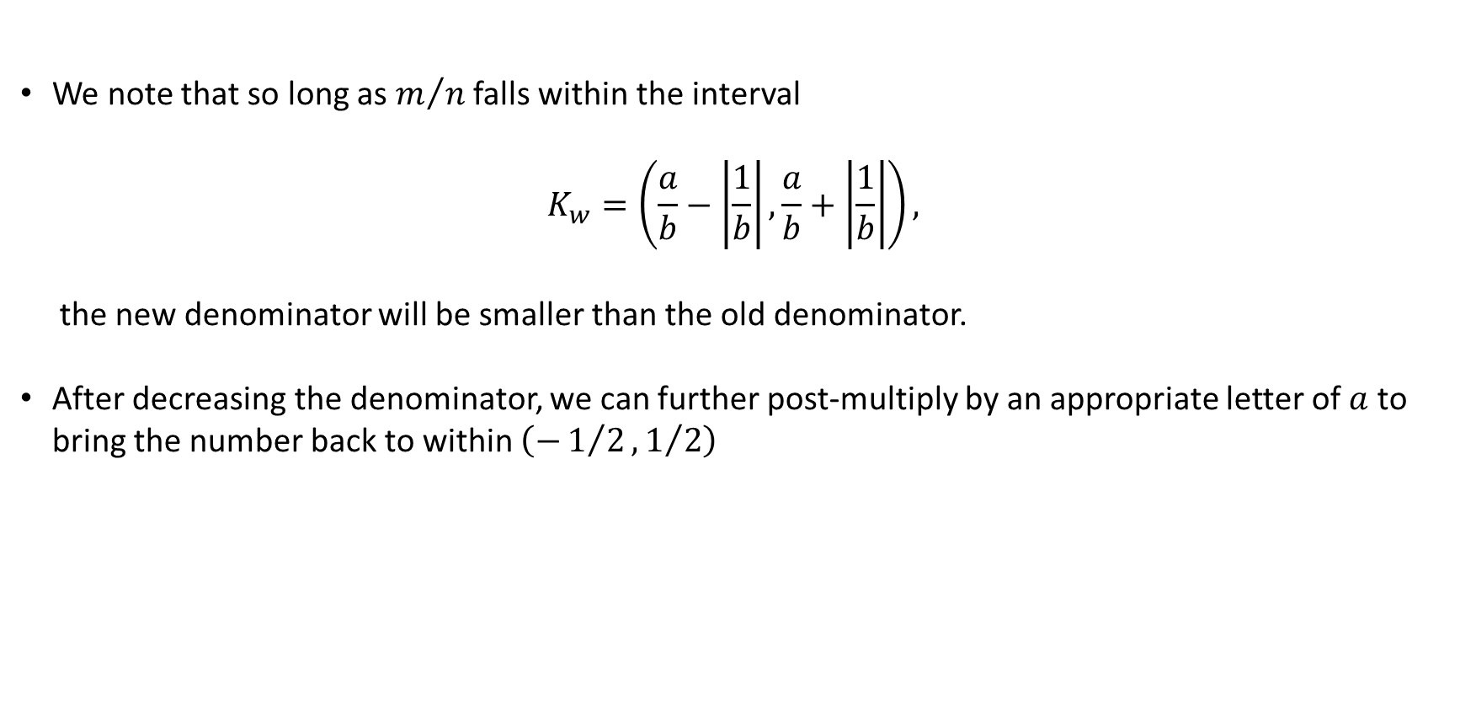
Killer Interval Algorithm: Killer Intervals
We note that so long as $m/n$ falls within the interval
$$K_{w}=\left(\frac{a}{b}−\left|\frac{1}{b}\right|,\frac{a}{b}+\left|\frac{1}{b}\right|\right),$$
the new denominator will be smaller than the old denominator.
After decreasing the denominator, we can further post-multiply by an appropriate letter of $a$ to bring the number back to within $\left(−1/2,1/2\right)$

Slide 15
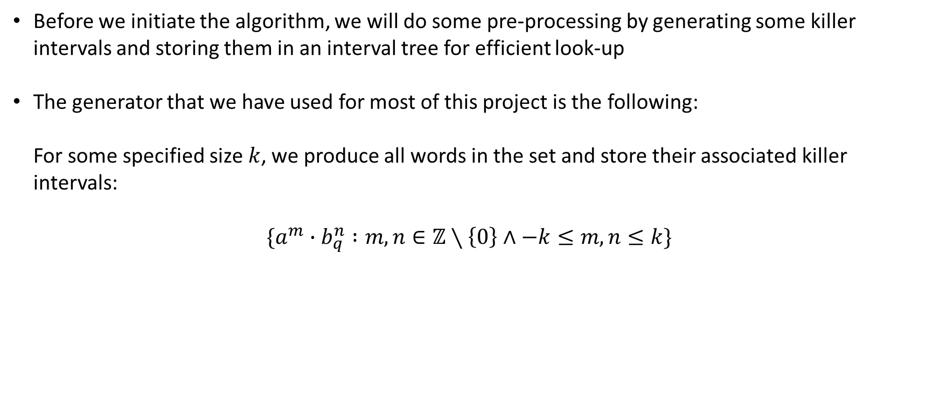
Killer Interval Algorithm: Pre-Processing
Before we initiate the algorithm, we will do some pre-processing by generating some killer intervals and storing them in an interval tree for efficient look-up
The generator that we have used for most of this project is the following:
For some specified size $k$, we produce all words in the set and store their associated killer
intervals:
$$\{a^{m}∙b_{q}^{n} :m,n∈ℤ∖\left\{0\right\}∧−k≤m,n≤k\}$$

Slide 16
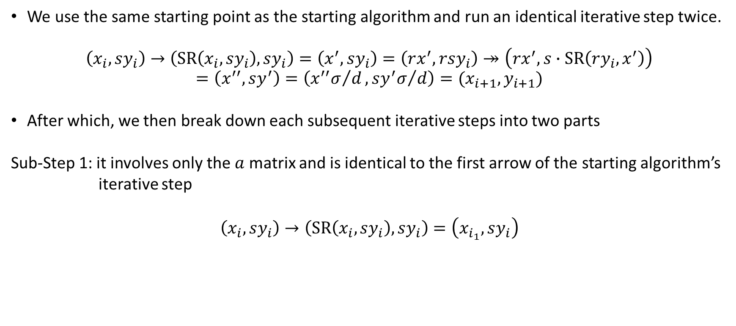
Killer Interval Algorithm
We use the same starting point as the starting algorithm and run an identical iterative step twice.
$$\left(x_{i},sy_{i}\right)→\left(SR\left(x_{i},sy_{i}\right), sy_{i}\right)=\left(x^{′},sy_{i}\right)=\left(rx^{′},rsy_{i}\right)↠\left(rx^{′},s∙SR\left(ry_{i},x^{′}\right)\right)$$
$$=\left(x^{′′},sy^{′}\right)=\left({x^{′′}σ}/d,{sy^{′}σ}/d\right)=(x_{i+1},y_{i+1})$$
After which, we then break down each subsequent iterative steps into two parts
Sub-Step 1: it involves only the $a$ matrix and is identical to the first arrow of the starting algorithm’s
iterative step
$$\left(x_{i},sy_{i}\right)→\left(SR\left(x_{i},sy_{i}\right), sy_{i}\right)=\left(x_{i_{1}},sy_{i}\right)$$

Slide 17
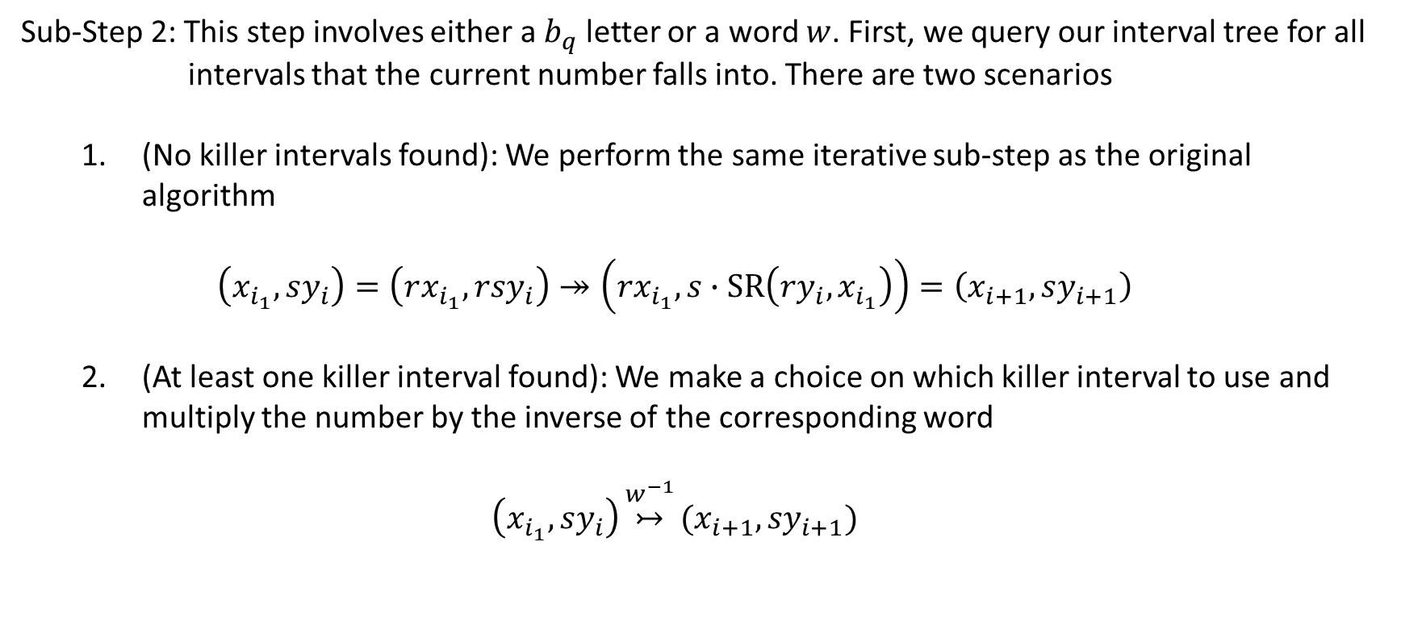
Killer Interval Algorithm
Sub-Step 2: This step involves either a $b_{q}$ letter or a word $w$. First, we query our interval tree for all
intervals that the current number falls into. There are two scenarios
(No killer intervals found): We perform the same iterative sub-step as the original algorithm
$$\left(x_{i_{1}}, sy_{i}\right)=\left(rx_{i_{1}},rsy_{i}\right)↠\left(rx_{i_{1}},s∙SR\left(ry_{i},x_{i_{1}}\right)\right)=\left(x_{i+1}, sy_{i+1}\right)$$
(At least one killer interval found): We make a choice on which killer interval to use and multiply the number by the inverse of the corresponding word
$$\left(x_{i_{1}}, sy_{i}\right)\underset{↣}{w^{−1}}(x_{i+1},{sy}_{i+1})$$

Slide 18
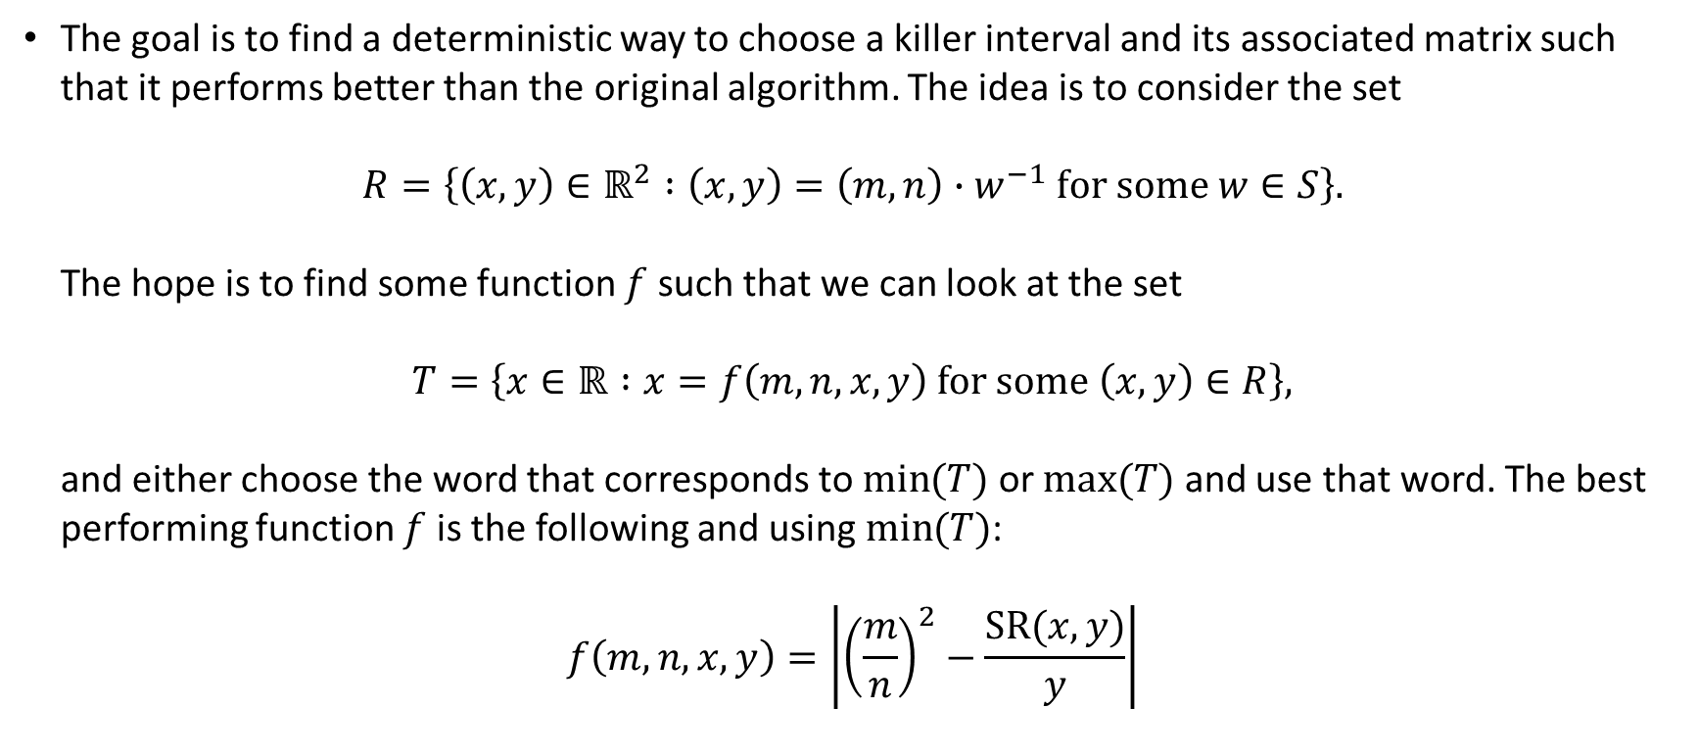
Killer Interval Algorithm: Deterministic Variant
The goal is to find a deterministic way to choose a killer interval and its associated matrix such that it performs better than the original algorithm. The idea is to consider the set
$$R=\left\{\left(x, y\right)∈ℝ^{2} :\left(x,y\right)=\left(m,n\right)∙w^{−1} for some w∈S\right\}.$$
The hope is to find some function $f$ such that we can look at the set
$$T=\left\{x∈ℝ :x=f\left(m,n,x,y\right) for some \left(x,y\right)∈R\right\},$$
and either choose the word that corresponds to $\min{(T)}$ or $max⁡(T)$ and use that word. The best
performing function $f$ is the following and using $\min{(T)}$:
$$f\left(m,n,x,y\right)=\left|{\left(\frac{m}{n}\right)}^{2}−\frac{SR(x,y)}{y}\right|$$

Slide 19
Killer Interval Algorithm: Randomised Variant
We similarly use the simple generator and select the interval with the midpoint furthest away from the current number.
After which, we then randomly select one of the matrices corresponding to the interval.
We then run this multiple times as most of the time it will fail to find a word that any of the other algorithms would have been able to.

Slide 20
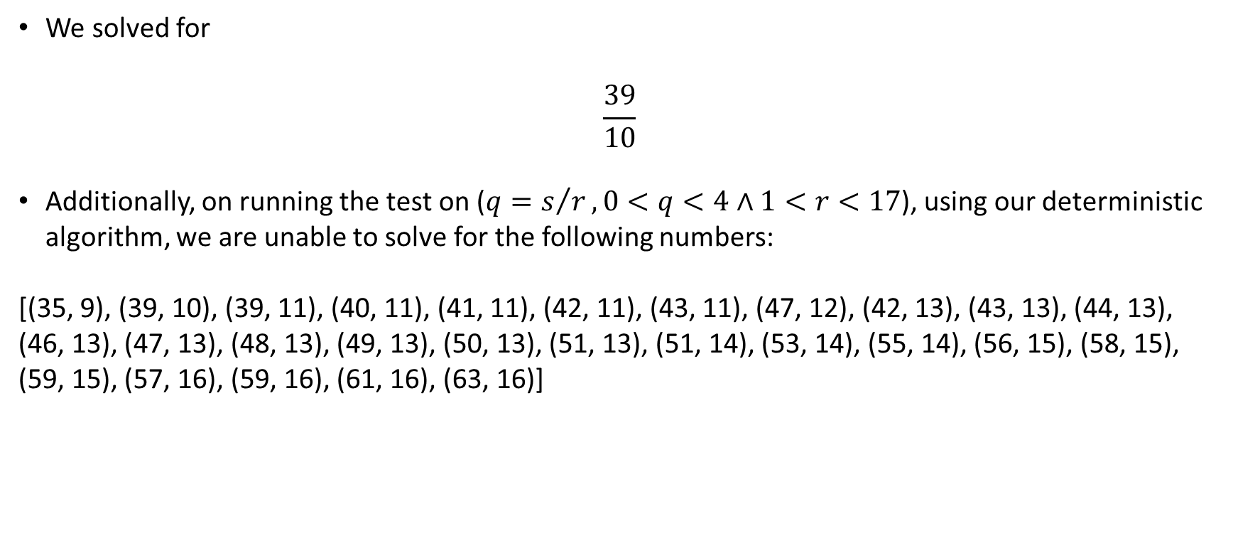
Summary of Results
We solved for
$$\frac{39}{10}$$
Additionally, on running the test on ($q=s/r, 0<q<4∧1<r<17$), using our deterministic algorithm, we are unable to solve for the following numbers:
[(35, 9), (39, 10), (39, 11), (40, 11), (41, 11), (42, 11), (43, 11), (47, 12), (42, 13), (43, 13), (44, 13), (46, 13), (47, 13), (48, 13), (49, 13), (50, 13), (51, 13), (51, 14), (53, 14), (55, 14), (56, 15), (58, 15), (59, 15), (57, 16), (59, 16), (61, 16), (63, 16)]

Slide 21
Summary of Results
On running our randomised variant, we are further able to solve the following few numbers:
[(39, 10), (39, 11), (41, 11), (42, 13), (43, 13), (44, 13), (51, 14), (57, 16)]
Leaving behind the following unsolved numbers:
[(35, 9), (40, 11), (42, 11), (43, 11), (47, 12), (46, 13), (47, 13), (48, 13), (49, 13), (50, 13), (51, 13), (53, 14), (55, 14), (56, 15), (58, 15), (59, 15), (59, 16), (61, 16), (63, 16)]

Slide 22
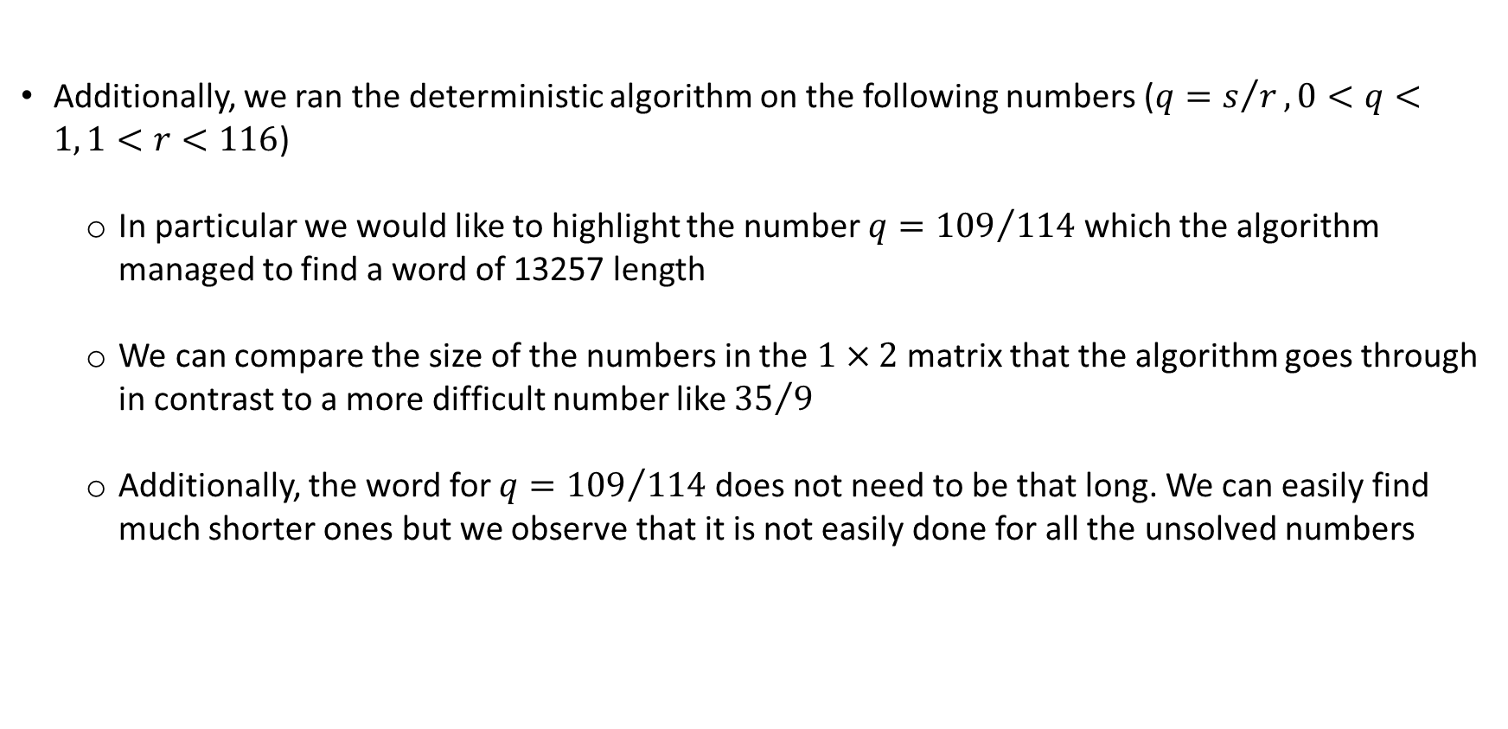
Summary of Results
Additionally, we ran the deterministic algorithm on the following numbers ($q=s/r, 0<q<1, 1<r<116$)
In particular we would like to highlight the number $q={109}/{114}$ which the algorithm managed to find a word of 13257 length
We can compare the size of the numbers in the $1×2$ matrix that the algorithm goes through in contrast to a more difficult number like ${35}/9$
Additionally, the word for $q={109}/{114}$ does not need to be that long. We can easily find much shorter ones but we observe that it is not easily done for all the unsolved numbers

Slide 23
Summary of Results
Comparing performance of the original algorithm with our deterministic algorithm
Criterion for comparison of performance between algorithm A and B:
If algorithm A is able to solve for a word that algorithm B is unable to, we say that algorithm A is better
If both algorithm A and B are able to solve for a word but algorithm A finds a significantly shorter word than B, we say that algorithm A performs better

Slide 24
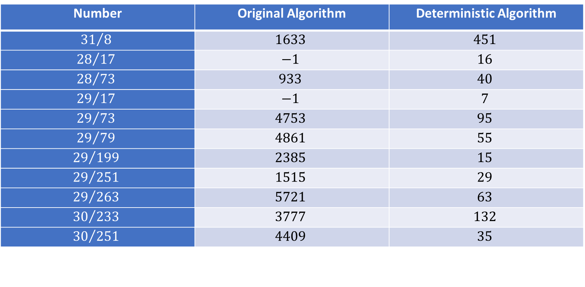
Summary of Results
Number | Original Algorithm | Deterministic Algorithm
$${31}/8$$ | $$1633$$ | $$451$$
$${28}/{17}$$ | $$−1$$ | $$16$$
$${28}/{73}$$ | $$933$$ | $$40$$
$${29}/{17}$$ | $$−1$$ | $$7$$
$${29}/{73}$$ | $$4753$$ | $$95$$
$${29}/{79}$$ | $$4861$$ | $$55$$
$${29}/{199}$$ | $$2385$$ | $$15$$
$${29}/{251}$$ | $$1515$$ | $$29$$
$${29}/{263}$$ | $$5721$$ | $$63$$
$${30}/{233}$$ | $$3777$$ | $$132$$
$${30}/{251}$$ | $$4409$$ | $$35$$

Slide 25
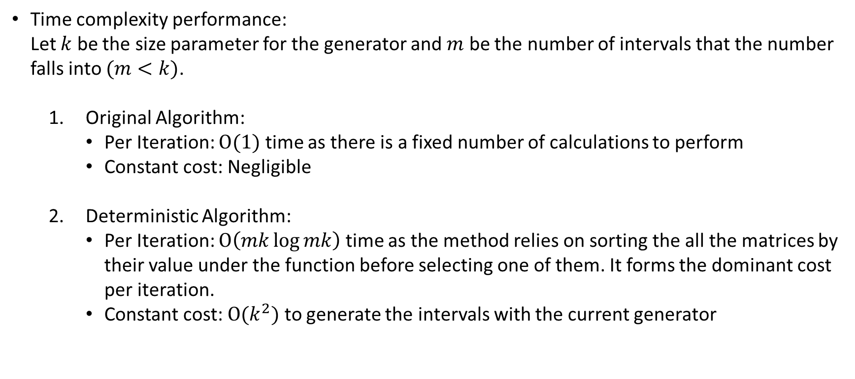
Summary of Results
Time complexity performance:
Let $k$ be the size parameter for the generator and $m$ be the number of intervals that the number
falls into $(m<k)$.
Original Algorithm:
Per Iteration: $O(1)$ time as there is a fixed number of calculations to perform
Constant cost: Negligible
Deterministic Algorithm:
Per Iteration: $O\left(mk\log{mk}\right)$ time as the method relies on sorting the all the matrices by their value under the function before selecting one of them. It forms the dominant cost per iteration.
Constant cost: $O(k^{2})$ to generate the intervals with the current generator

Slide 26
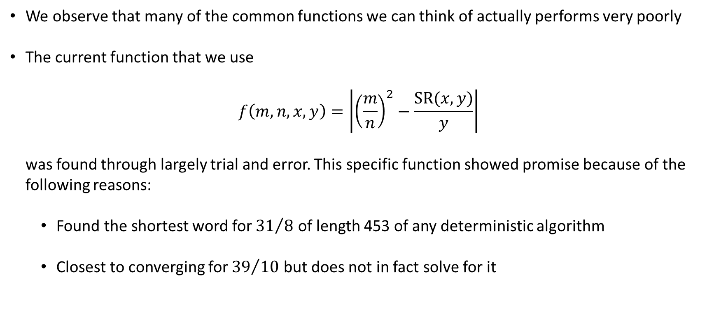

Remarks on Function $f$ of Deterministic Algo
We observe that many of the common functions we can think of actually performs very poorly
The current function that we use
$$f\left(m,n,x,y\right)=\left|{\left(\frac{m}{n}\right)}^{2}−\frac{SR(x,y)}{y}\right|$$
was found through largely trial and error. This specific function showed promise because of the
following reasons:
Found the shortest word for ${31}/8$ of length 453 of any deterministic algorithm
Closest to converging for ${39}/{10}$ but does not in fact solve for it

Slide 27
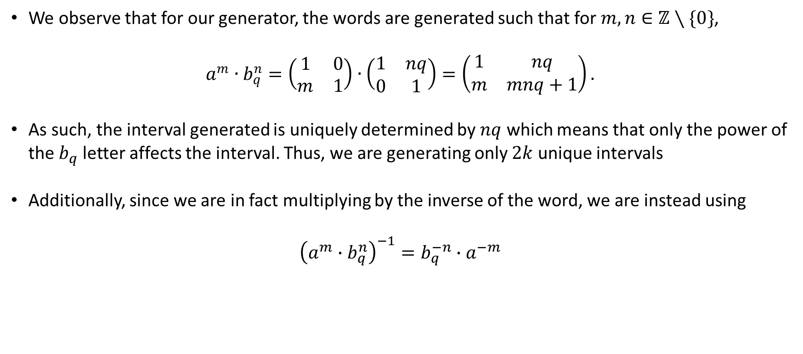
Remarks on Randomised Algorithm
We observe that for our generator, the words are generated such that for $m,n∈ℤ∖\{0\}$,
$$a^{m}∙b_{q}^{n}=\left(\begin{matrix}1 & 0 \\ m & 1\end{matrix}\right)∙\left(\begin{matrix}1 & nq \\ 0 & 1\end{matrix}\right)=\left(\begin{matrix}1 & nq \\ m & mnq+1\end{matrix}\right).$$
As such, the interval generated is uniquely determined by $nq$ which means that only the power of the $b_{q}$ letter affects the interval. Thus, we are generating only $2k$ unique intervals
Additionally, since we are in fact multiplying by the inverse of the word, we are instead using
$${\left(a^{m}∙b_{q}^{n}\right)}^{−1}=b_{q}^{−n}∙a^{−m}$$

Slide 28
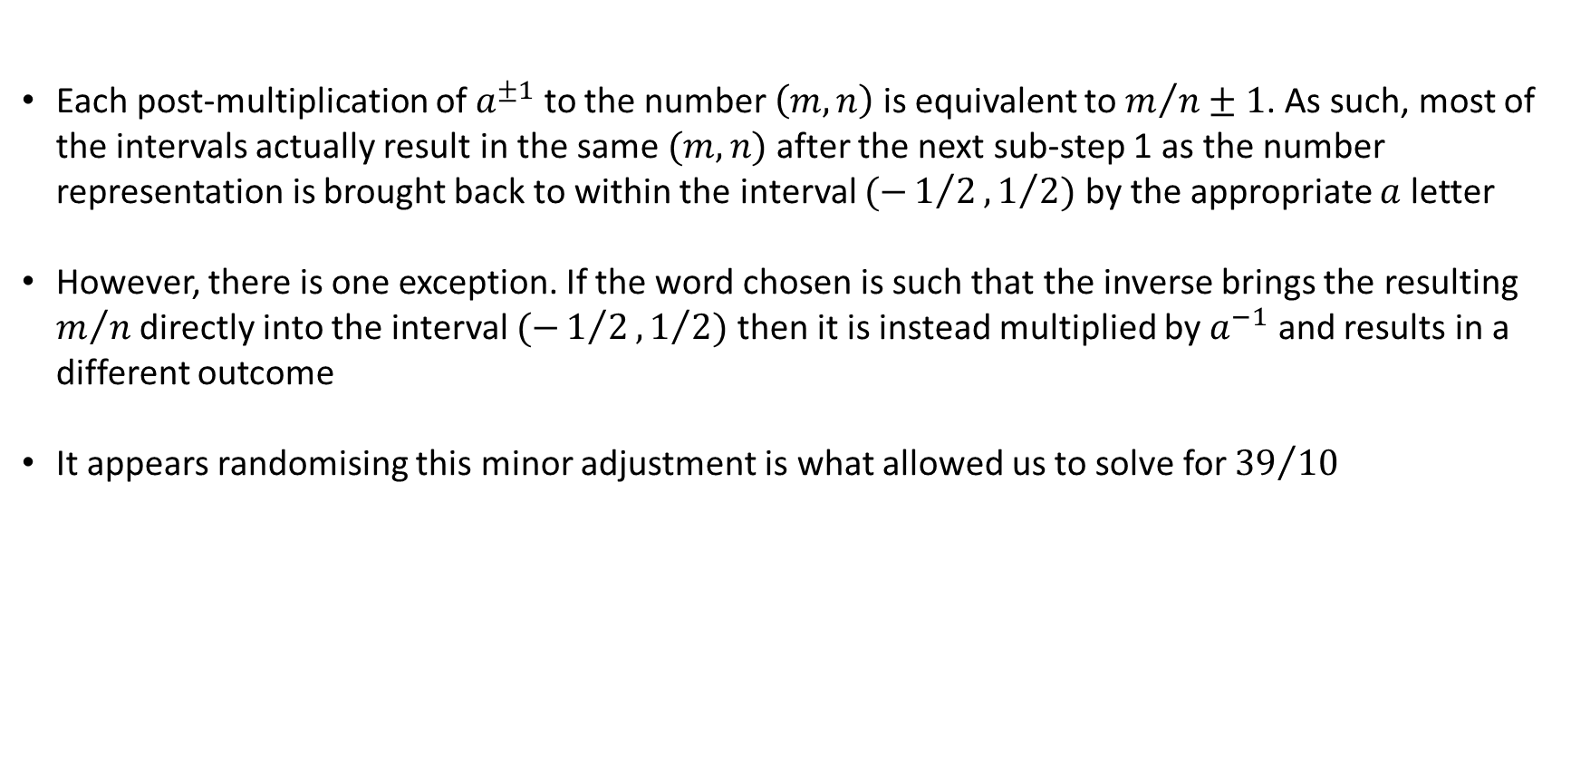
Remarks on Randomised Algorithm
Each post-multiplication of $a^{±1}$ to the number $\left(m, n\right)$ is equivalent to $m/n±1$. As such, most of the intervals actually result in the same $(m,n)$ after the next sub-step 1 as the number representation is brought back to within the interval $(−1/2,1/2)$ by the appropriate $a$ letter
However, there is one exception. If the word chosen is such that the inverse brings the resulting $m/n$ directly into the interval $(−1/2,1/2)$ then it is instead multiplied by $a^{−1}$ and results in a different outcome
It appears randomising this minor adjustment is what allowed us to solve for ${39}/{10}$

Slide 29
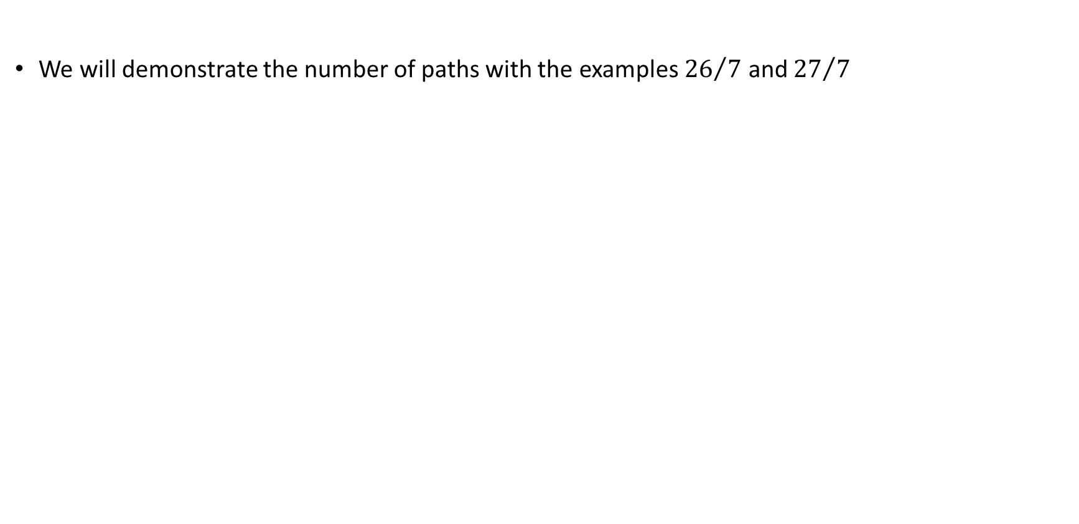
Remarks on Number of Paths
We will demonstrate the number of paths with the examples ${26}/7$ and ${27}/7$

Slide 30
Thank You

